Slide 1
Superstore Sales Performance & Profit Analysis By- Pooja Chaudhary Pawar

Slide 2
Business Goal
Analyze sales, profit, customer behavior, product performance and regional trends to support data-driven decisions.

Slide 3
Tools & Technologies
Tools Used-
Excel, Power Query, MySQL, Python (Pandas, Matplotlib), Power BI, DAX, Data Modeling.

Slide 4
Data Preparation
Data Cleaning Process -
Removed invalid records, fixed date formats, handled missing values, created Revenue column and validated data.

Slide 5
SQL Analysis
Business Queries -
Monthly Revenue, Top 10 Products, Revenue by Region, Customers with Multiple Orders.

Slide 6
Python EDA
Exploratory Data Analysis
Revenue trends, category performance, customer behavior, and business visualizations.

Slide 7

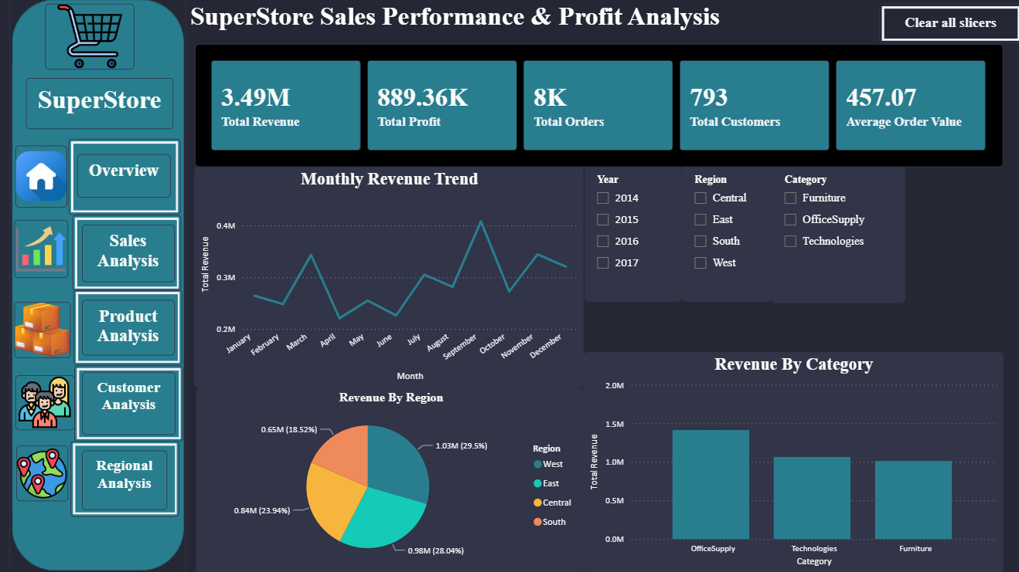
Dashboard Overview
KPIs: Revenue, Profit, Orders, Customers, AOV. Visuals: Revenue Trend, Category Analysis, Regional Revenue.

Slide 8
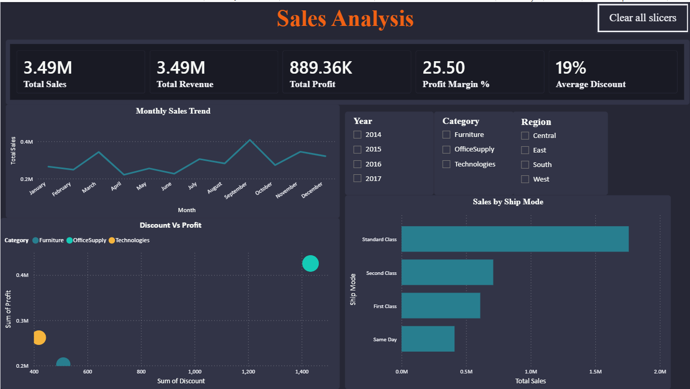
Sales Dashboard
Revenue Growth, Profit Margin, Monthly Trend, Discount vs Profit Scatter Plot, Sales Performance Analysis.

Slide 9
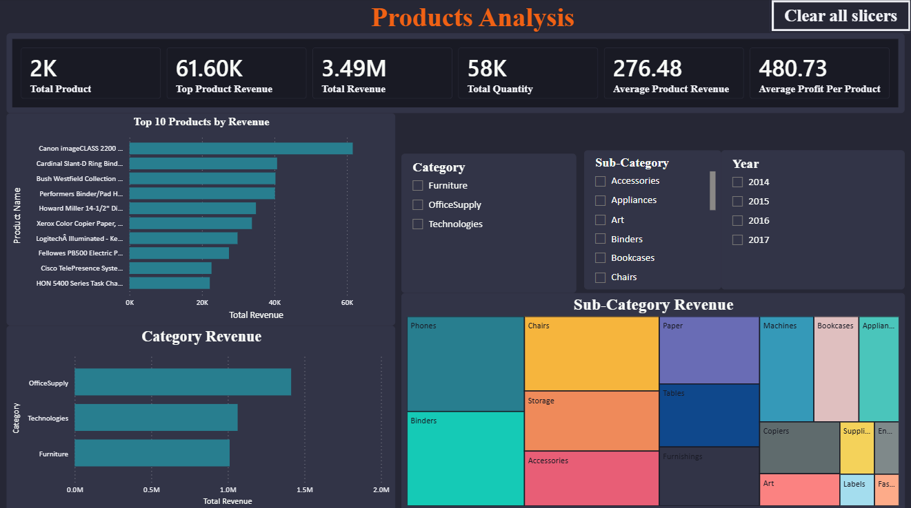
Products Dashboard
Top 10 Products by Revenue, Category Revenue, Treemap Analysis, Product Profitability.

Slide 10
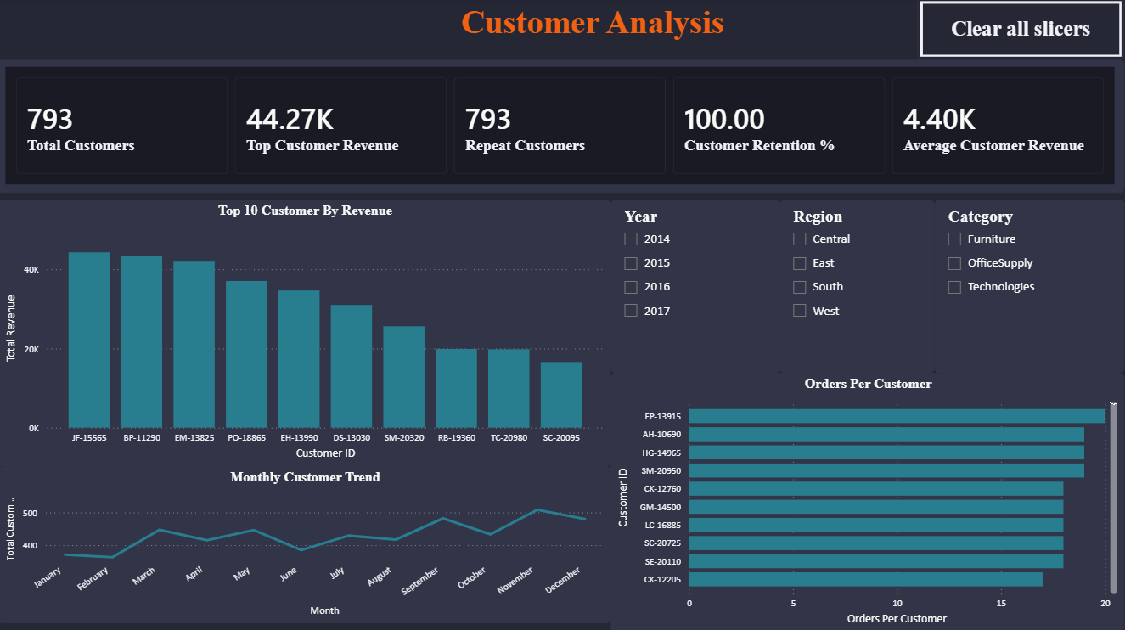
Customer Dashboard
Customer Growth Trend, Top Customers by Revenue, Orders per Customer.

Slide 11
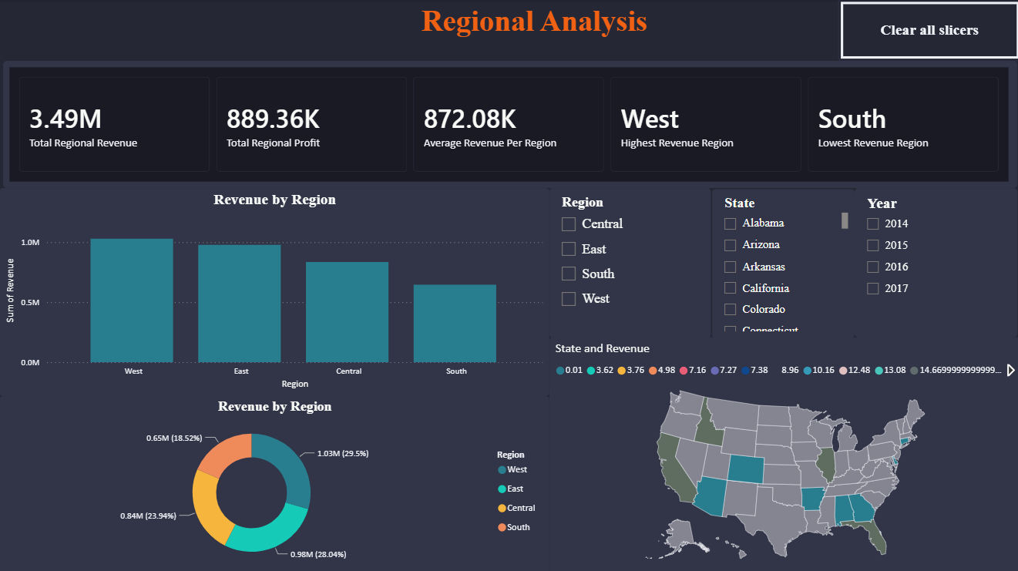
Regional Dashboard
Revenue by Region, Profit by Region, Top States by Revenue, Regional Comparison

Slide 12
Business Insights
Insights -
Identify best-selling products, profitable regions, customer contribution, and sales opportunities.

Slide 13
Business Recommendations
Recommendations -
Optimize discounts, focus on high-margin products, target high-value customers.

Slide 14
Conclusion
Successfully analysed Superstore sales data using Excel, SQL, Python, and Power BI.
Cleaned and transformed data to ensure accurate analysis.
Identified top-performing products, customers, and regions.
Analysed sales trends, profitability, and customer behaviour.
Built an interactive Power BI dashboard with key business KPIs.
Generated actionable insights to support data-driven decision-making.
Recommended focusing on high-profit products, valuable customers, and optimized discount strategies

Slide 15
Future Scope
Sales forecasting using Machine Learning.
Customer segmentation and retention analysis.
Inventory and demand forecasting.
Advanced predictive analytics for business growth.

Slide 16
References
Superstore Sales Dataset
Microsoft Excel & Power Query Documentation
MySQL Documentation
Python Documentation
Pandas & Matplotlib Documentation
Microsoft Power BI Documentation

